Slide 1
Accessing the Curriculum for Diverse Learners
The “how” of instruction

Slide 2

Activity: Case Studies
Work in small groups.
Imagine you are a team of EAs, supporting the student described in the case study.
Be prepared to provide the rationale behind your choices.

Slide 3
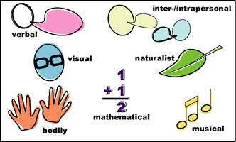
Individual Differentiation
Review chart on pg. 415
What solutions could you implement?
What solutions need clarifying?
What solutions do you questions – what might be a more appropriate option for that multiple intelligence?

Slide 4

Pulling the pieces together
EA role is to support teacher and student
Student participation = meaningful learning
Many concepts and practices support and inform the thinking and implementing of educational practices

Slide 5

Supporting students
When asked, could you fill in the blanks?
Students are learning about the bone structure of dinosaurs (PLO from Science). The are ___________. Samuel (focus student) is ___________. I (EA) am _______________ because ___________.

Slide 6
Activity: Pulling the pieces together
Use the provided word list
Place each word at the appropriate place in the decision making process
When finished discuss your responses with a classmate
Discuss responses and questions with the class

Slide 7
Adaptations and Modifications
Quantity | Time | Level of Support
Input | Difficulty | Output
Participation | Alternative Goals | Substitute Curriculum

Slide 8

Participation Options
1
Same thing, same way
2
Same thing, different way
3
Same activity (or component), different goals

Slide 9

Participation Options
4
Same materials, different activity
5
Different Activity

Slide 10

The “how” of instruction
The act of supporting or instructing requires EAs to actively:
Preplan
Organize
Observe
Think
Adapt / modify
Communicate
Be flexible
Work “on-the-fly”

Slide 11

Learning, participation and membership
Engaged behaviour is the single best predictor of academic gains for students with disabilities
The amount of time students with cognitive disabilities are actively engaged in activities has been cited as one of the best predictors of outcomes for these students

